Slide 1
Excess and Umbrella Insurance

Slide 2



What will we learn?
The topic we will learn about are as follows:
Why do we need Excess and Umbrella liability insurance?
What is Commercial Excess Liability Insurance?
Primary vs Excess policies
Basic forms of an Excess liability policy
What is Commercial Umbrella Liability Insurance?
Difference between Excess & Umbrella Liability policies
Other key concepts:
Insuring Agreement

Slide 3
Why do we need Excess and Umbrella liability insurance?

Slide 4



Why do we need Excess and Umbrella liability insurance?
There are 3 basic characteristics of liability insurance that are not shared by property insurance:
Difficulty in estimating probable maximum loss (PML)
Layering of liability coverages
Effect of aggregate limit
PML is the largest loss that could be sustained in a particular occurrence or by a particular organization.
Most property loss exposures have a reasonable PML. However, this is not the case for most liability exposures due to unpredictably enormous amounts owed to the injured 3rd party.
Most property exposures are covered by a single insurer or multiple insurers on a pro-rata basis as per proportional contribution.
In contrast, high limit liability insurance is arranged in 2 or more layers, i.e. the 1st layer (primary) must be completely exhausted before the next layer makes any payment for a claim.
Unlike property insurance, liability insurance is usually subject to an aggregate limit for the policy period.
Hence, insureds could face situations where a large claim’s verdict remains unfinalized, exhausts the primary layer’s aggregate limit and leaves the claim uninsured.

Slide 5

Knowledge Check
XYZ Manufacturing has a CGL coverage form with:
Each Occurrence limit: $2,000,000
General Aggregate limit: $3,000,000
Aggregate limit for products and completed operations: $3,000,000
If XYZ has products liability losses of $1,500,000, $1,200,000 and $500,000 during the policy period, how much would the CGL policy pay for the losses?
$1,500,000
$2,000,000
$3,000,000
$3,200,000
Answer: The CGL policy would pay $3,000,000 ($1,500,000 + $1,200,000 + $300K) as the total aggregate limit for products and completed operations is strictly $3,000,000 even if the each occurrence limit will ideally cover each of the 3 product claims (as they are well within $2,000,000 each).
This leaves out $200,000 which the CGL policy will not cover since the products and completed operations aggregate is now exhausted. Hence, the insured would need to purchase an excess/umbrella policy as an additional layer to cover the remaining uninsured cost.

Slide 6
What is Commercial Excess Liability Insurance?

Slide 7
What is Commercial Excess Liability Insurance?
In order to understand Commercial Excess liability, let us first understand the role of a primary policy layer.
A primary policy typically pays the “first dollar” of covered claims – often subject to a deductible amount that the insurer bills back to the policyholder – or frequently applying only after the policyholder has paid a specified amount, which is also known as self-insured retention (“SIR”).
Policy C: 2nd Excess layer
($15 million xs $15 million)
Policy B: 1st Excess layer
($10 million xs $5 million)
Policy A: Primary layer
($5 million)
For example: A policyholder might obtain:
A $5 million primary policy (Policy A),
A first-layer excess policy with limits $10 million excess of $5 million (Policy B),
A second-layer excess policy with limits $15 million excess of $15 million (Policy C).
Claim payment

Slide 8
What is Commercial Excess Liability Insurance?
Therefore, an excess liability policy covers liability claims in excess of the limits of an underlying policy (which can be the primary layer or an underlying excess layer) or stated retention amount.
An excess liability policy is no broader than the underlying liability policy; its sole purpose is to provide additional limits of insurance.
Hence, in a real-life scenario: When a claim is reported to the insurance company, the first policy to respond is the underlying primary, whether it’s auto liability, general liability or even employer’s liability. If the claim exhausts the limits in the primary policy, the excess liability policy picks up where the primary left off.
Excess coverage is a product available in virtually all lines of commercial insurance: commercial general liability (“CGL”), directors and officers (“D&O”), errors and omissions (“E&O”), business interruption, aviation, etc.

Slide 9
Basic forms of a Commercial Excess Liability policy
There exist 3 basic forms of any Commercial excess liability policy, which are:
“Following form”
Self-contained
Combined
A following form excess policy covers a liability loss that exceeds the underlying limits only if the loss is covered by the underlying insurance policy as well.
Eg: Let’s assume that an insured has a policy wherein:
Underlying policy each occurrence limit: $1 MM
Excess policy each occurrence limit: $1 MM
Claim amount: $1,250,000
In this case, the underlying policy will pay $1,000,000 and remaining $250,000 will be covered by the excess policy provided the T&Cs are the same as the underlying policy.
A self-contained excess policy applies to a loss that exceeds the underlying limits and is also covered under the specific terms of the excess policy (which could differ from those applied in the underlying policy).
Eg: An excess policy may not cover injury within the products & completed operations hazard, even though the underlying policy does.
In such a case, the excess policy would not pay for a products liability claim, even though the claim was covered by the underlying policy and exceeded each occurrence limit of the underlying policy.
An excess policy may combine both of these approaches (following form and self-contained) by incorporating the provisions of the underlying policy and then modifying it with additional conditions/exclusions in the excess policy.

Slide 10




What is Commercial Umbrella Liability Insurance?
It provides excess coverage over several primary or underlying coverages like CGL, Auto, EPL, etc. (just like any regular excess liability policy)
It may cover some claims that are not covered by the insured’s primary policies
It takes the place of the primary insurance when primary aggregate limits are reduced or exhausted

Slide 11
Summary - Difference between Excess & Umbrella Liability policies

Slide 12
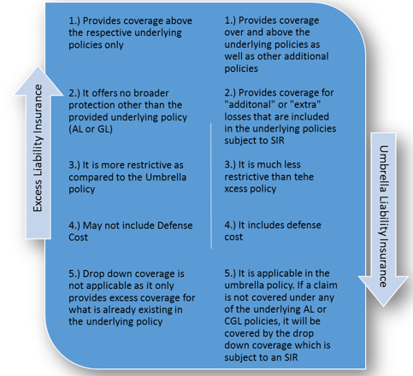
Summary - Difference between Excess & Umbrella Liability policies

Slide 13
Other Key Concepts

Slide 14
Other key concepts
Insuring Agreement
Many umbrella liability policies contain one comprehensive insuring agreement instead of several specific ones. A common approach is for the insurer to promise to pay the amount in excess of the underlying limit that the insured becomes legally obligated to pay as damages for bodily injury, property damage, personal injury, or advertising injury arising out of an occurrence to which the policy applies, subject to the umbrella policy limit.
Other umbrella policies use two insuring agreements, often referred to as “A” and “B”. In effect, these policies combine an excess policy and an umbrella policy in one policy.
• Insuring agreement A: is an excess coverage applying over the underlying policies.
• Insuring agreement B: applies to occurrences for which coverage is available under the umbrella but not in the underlying policies.

Slide 15
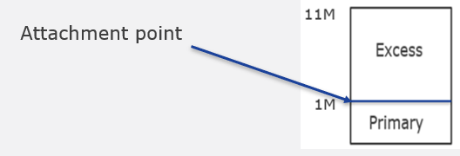
Other key concepts
Working Layer: A dollar range in which an insured or, in the case of an insurer's book of business, a group of insureds is expected to experience a high level of loss frequency. This is the layer typically subject to deductibles, self-insured retentions, and similar programs.
Buffer Layer:
An insured may have a primary policy that only protects them up to a certain dollar amount and an umbrella policy that covers them at a higher level.
In between those two coverage points is a layer of liability (buffer layer) that companies must either decide to cover with an additional policy (say excess), or to risk having to pay out of pocket should a claim be filed.
Attachment Point: In an insurance tower every layer has an attachment point wherein a particular layer starts paying.

Slide 16
Thank You!

